Slide 1

Space Program of Russian Federation
Trends and Challenges
17.06.2011

Slide 2
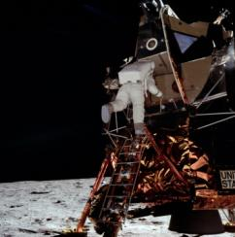
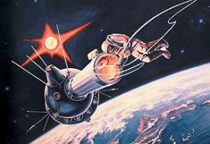
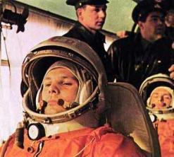
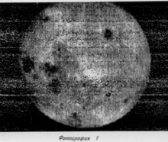
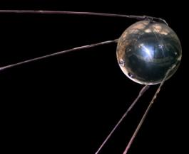
On Space age start
1969
1965
1961
First decade of the Space Age was characterized by a fast qualitative and quantitative development of space activities
1959
1957

Slide 3
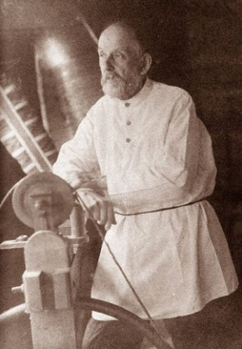
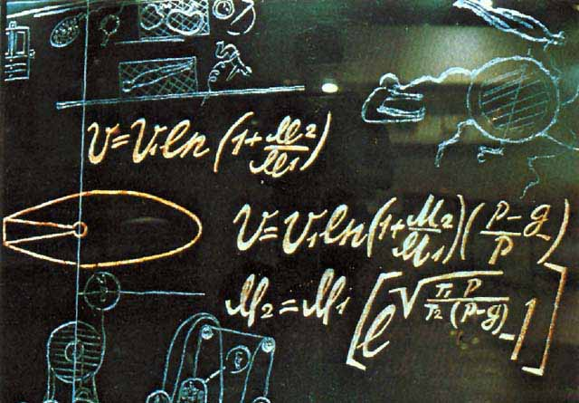
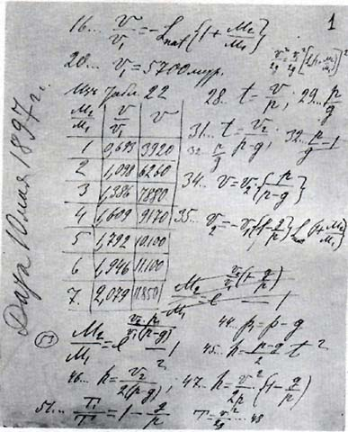

Slide 4

Project Apollo, 1961-1972
Project Apollo met its target, it helped to implement most of recent technologies into various areas of technics and economics
However…
Project Apollo was ahead the time.
The U.S . couldn`t provide sufficient logistics for the lunar research and exploration as it was originally planned

Slide 5
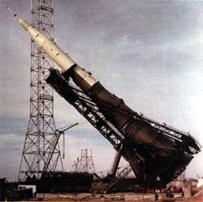
N1-L3 Project mission to the Moon planned by Russia
in 1964-1974
Key mistakes:
Delay in decision making on the project (1964 vs. 1961 - three years are lost);
Possibility for, but in fact even stimulation of competition among the performers at the stage of the project;
Failure to allocate sufficient funds for tests at the ground;
Failure to continue to work and complete the project

Slide 6
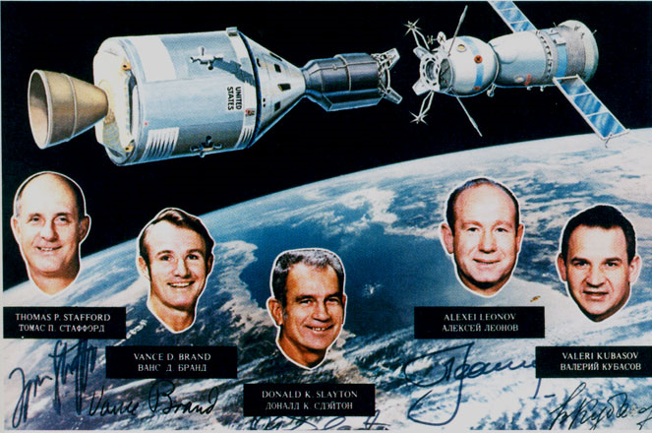
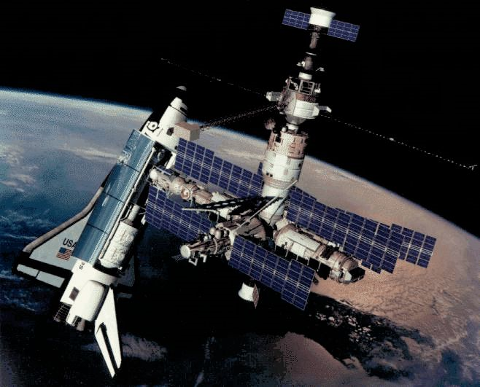
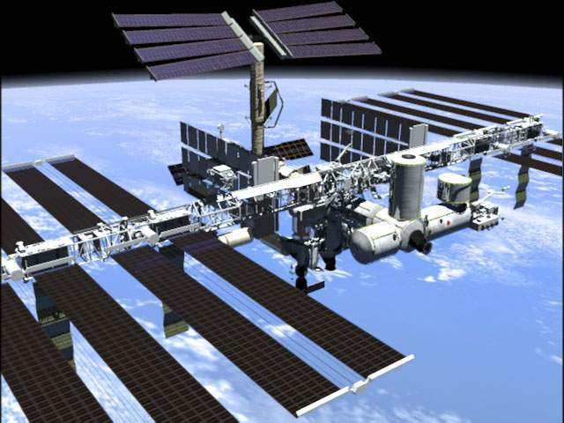
Soyuz-Apollo mission, 1975
Mir, 1986-2001
ISS, 1998 - ?

Slide 7
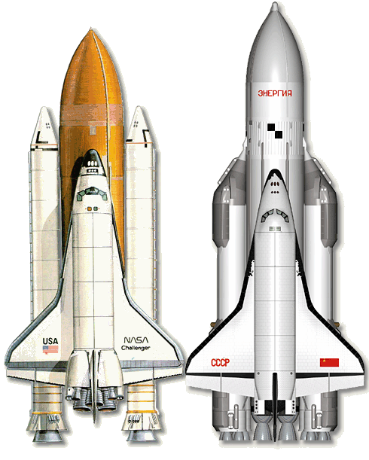
SHUTTLE
BURAN
Did not prove optimistic expectations. The development of astronautics in the U.S. slowed down twice: at the start of the project due to the premature failure of the single-carrier; and at the final stage due of technical inability to provide adequate system reliability. 120 successful flights have formed the current image of American and the world astronautics in a whole. | Complete failure… Reasons: the project was accepted by the USSR Government despite the negative opinions of military and civilian specialists; payloads for the vehicle were determined only on paper. Within the project super-heavy launch vehicle of a higher class has been created, which is not in use nowadays because of the economic crisis.

Slide 8
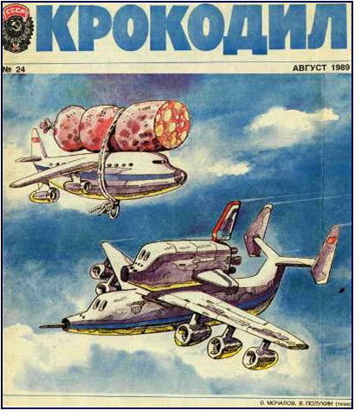
Situation in the country and the space industry in 1991
fight Communists vs. Democrats
the economic crisis and threat of famine
the prosecution on unjustified funds consumption
specialists, who are interested in aeronautics development, are trying to be united

Slide 9
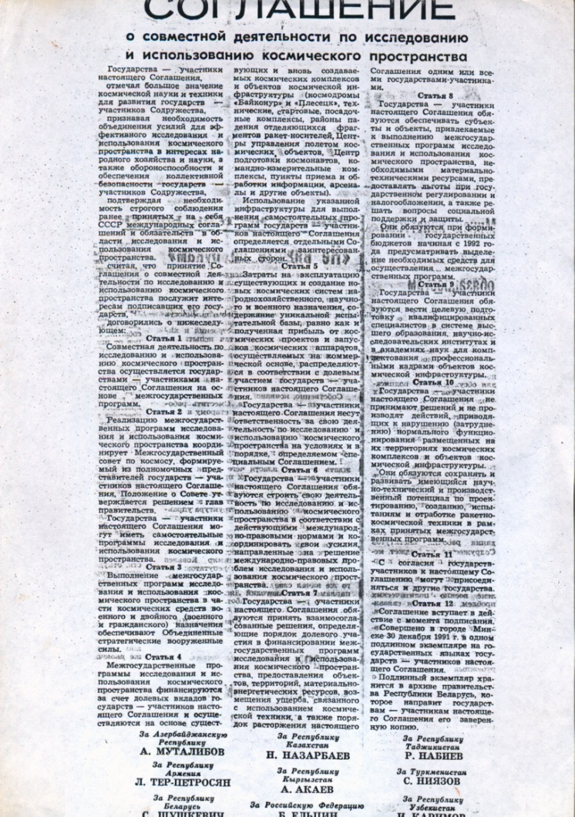
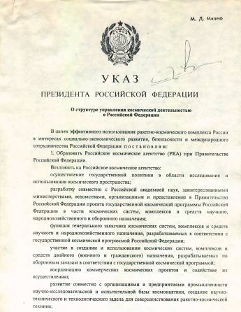

Results of Activities of the Working Team
On December 1991 was signed an
Agreement on Space collaboration with CIS countries
On 25th February 1992
was formed Russian Space Agency

Slide 10
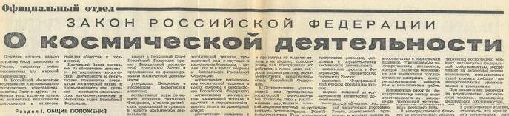
Law of Russian Federation On space activities
Developed by members of Moscow Space Club (V.Postyshev, I.Moiseev, А.Rudev, S.Krichevsky, N.Fefelov, А.Lapshin) under agreement between Supreme Council of Russian Federation and the Club.
On that that times this law was followed as thoroughly as none of others before. Armed Forces made the request in 200 addresses of different enterprises.
The law was signed by President of Russian Federation on October, 1993.
Achieved responses from the enterprises are saved despite the events of October 1993 and can be used for further legislative works

Slide 11
Launches 1957 – 2010
The intensity of space activities as a function of
socio-political realities

Slide 12
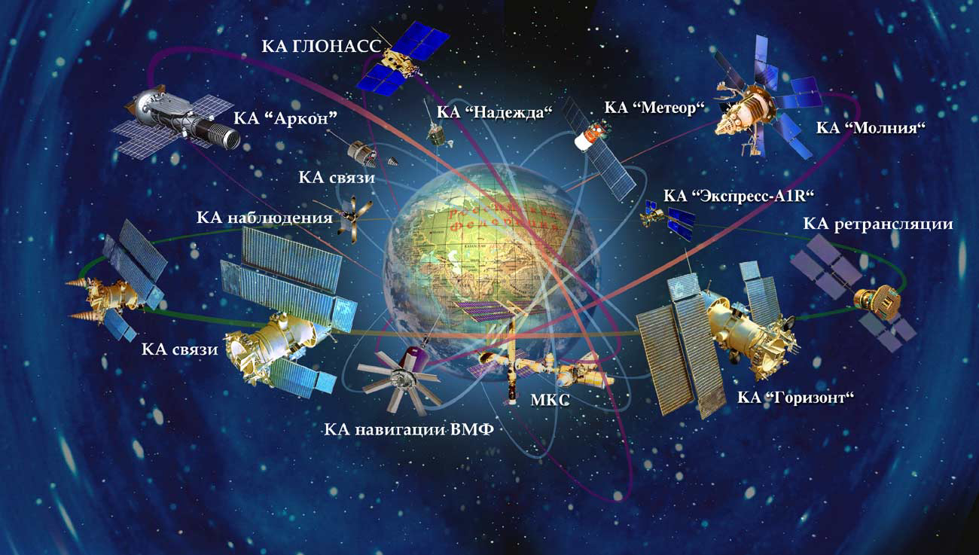
Astronautics in Russia today
2011

Slide 13
Strategic targets for Russia are:
to improve the quality of life;
to expedite economic growth;
to create potential for future development;
to improve national security.
Definite directions are determined by:
Federal Space Program of Russian Federation
for the period of 2006 - 2015
(approved by the Russian Government on 22d, October, 2005)
and by:
Global Navigation System
Development of launch sites in Russia for the period of
2006 - 2015
Notes:
См. график финансирования

Slide 14
Space potential of Russia
112 ventures and enterprises
250 000 employees (0,34% of all employed population)
95 billion rubles - financing from budget
of Russian Federation (1 % of all budget costs)

Slide 15
Space Industry in Russia

Slide 16





















Major Players
Governmental authorities
Vehicles
Engines
Satellites
Science
Operators

Slide 17
Notes:
Финансирование реальное, а не планируемое, по отчетам казначейства.

Slide 18







Space Fleet of Russian Federation
2006-2010

Slide 19
Usage intensity of the launch sites in Russia
2006 -2010

Slide 20
Main directions of space activities in Russia
2006-2010

Slide 21
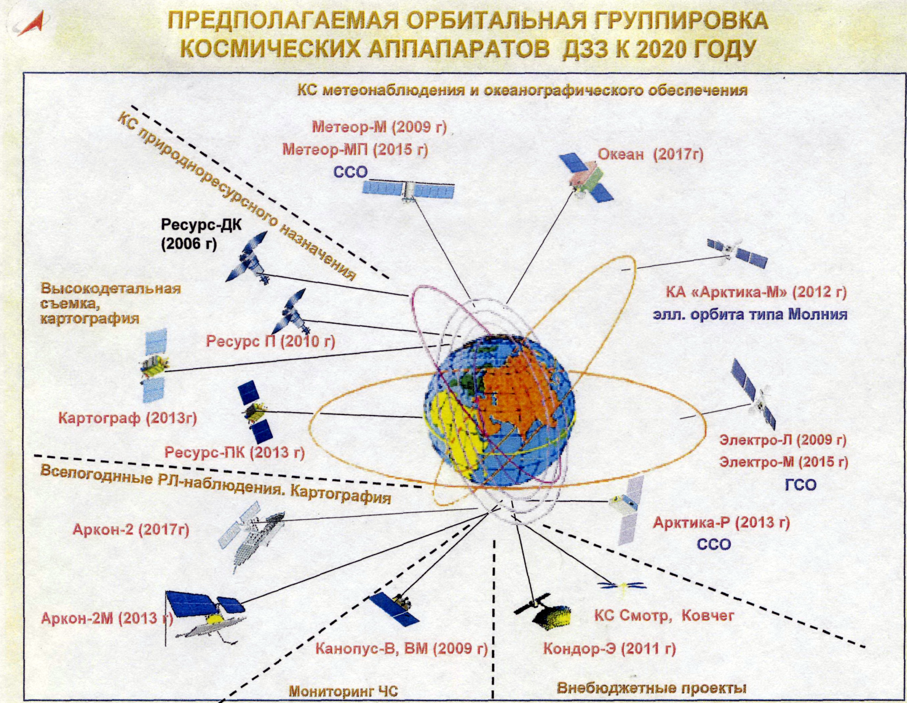
Near future problem is expansion use of results of space activity, increase competitiveness Russia in the world space market.
Prospective orbital group of spacecraft of remote sounding of the Earth by 2020.

Slide 22
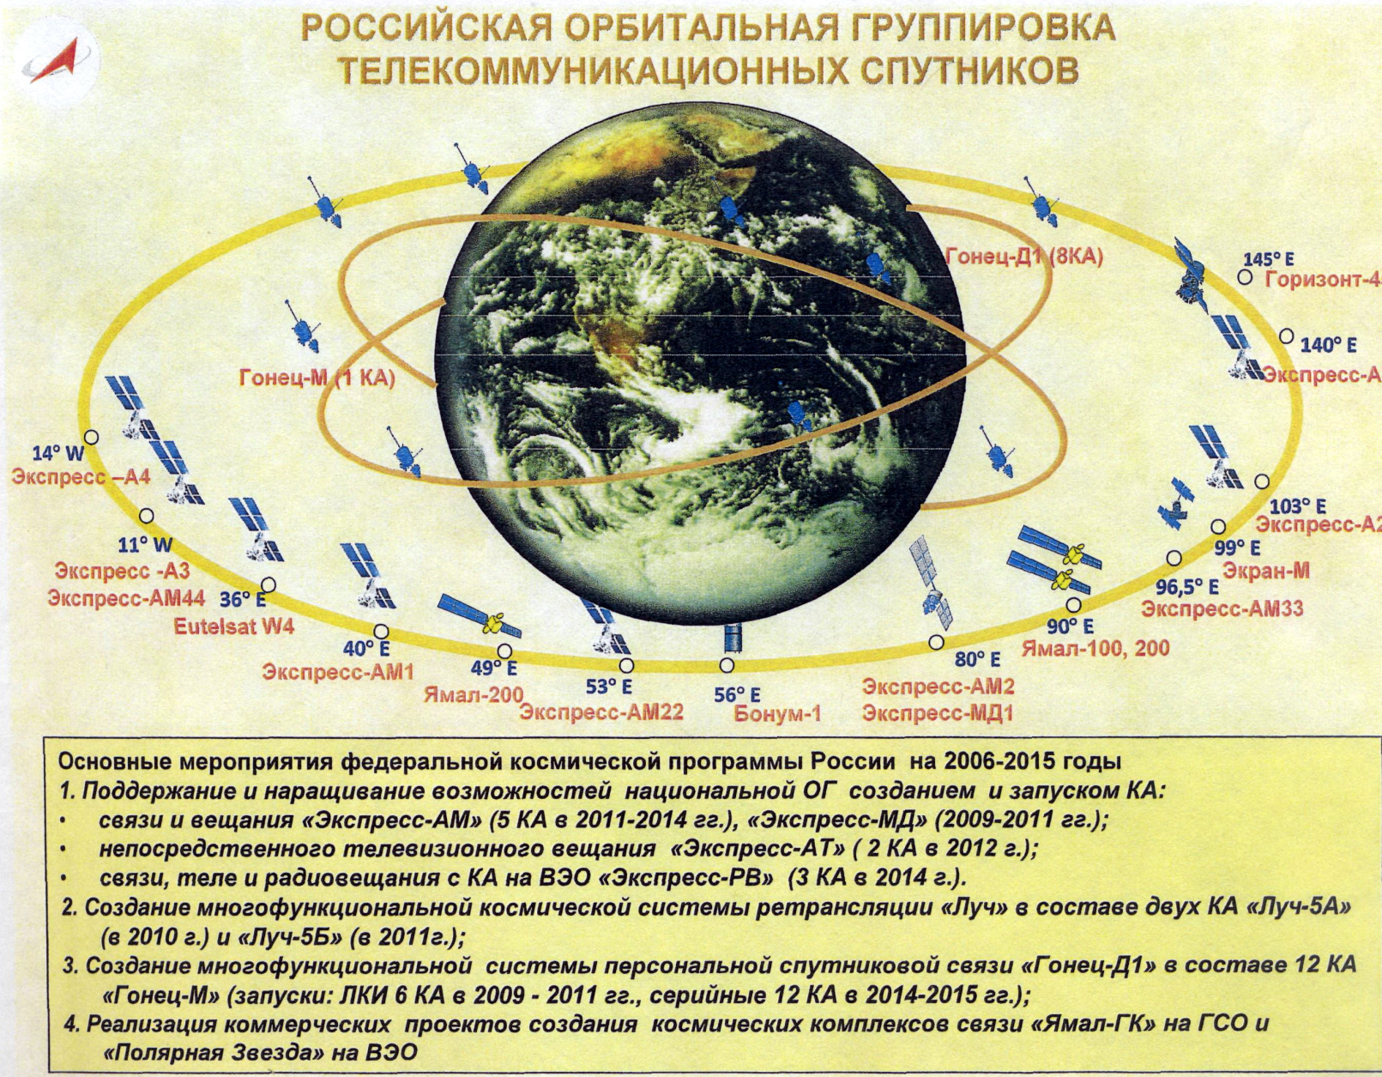
Russian orbital group of telecom satellites

Slide 23
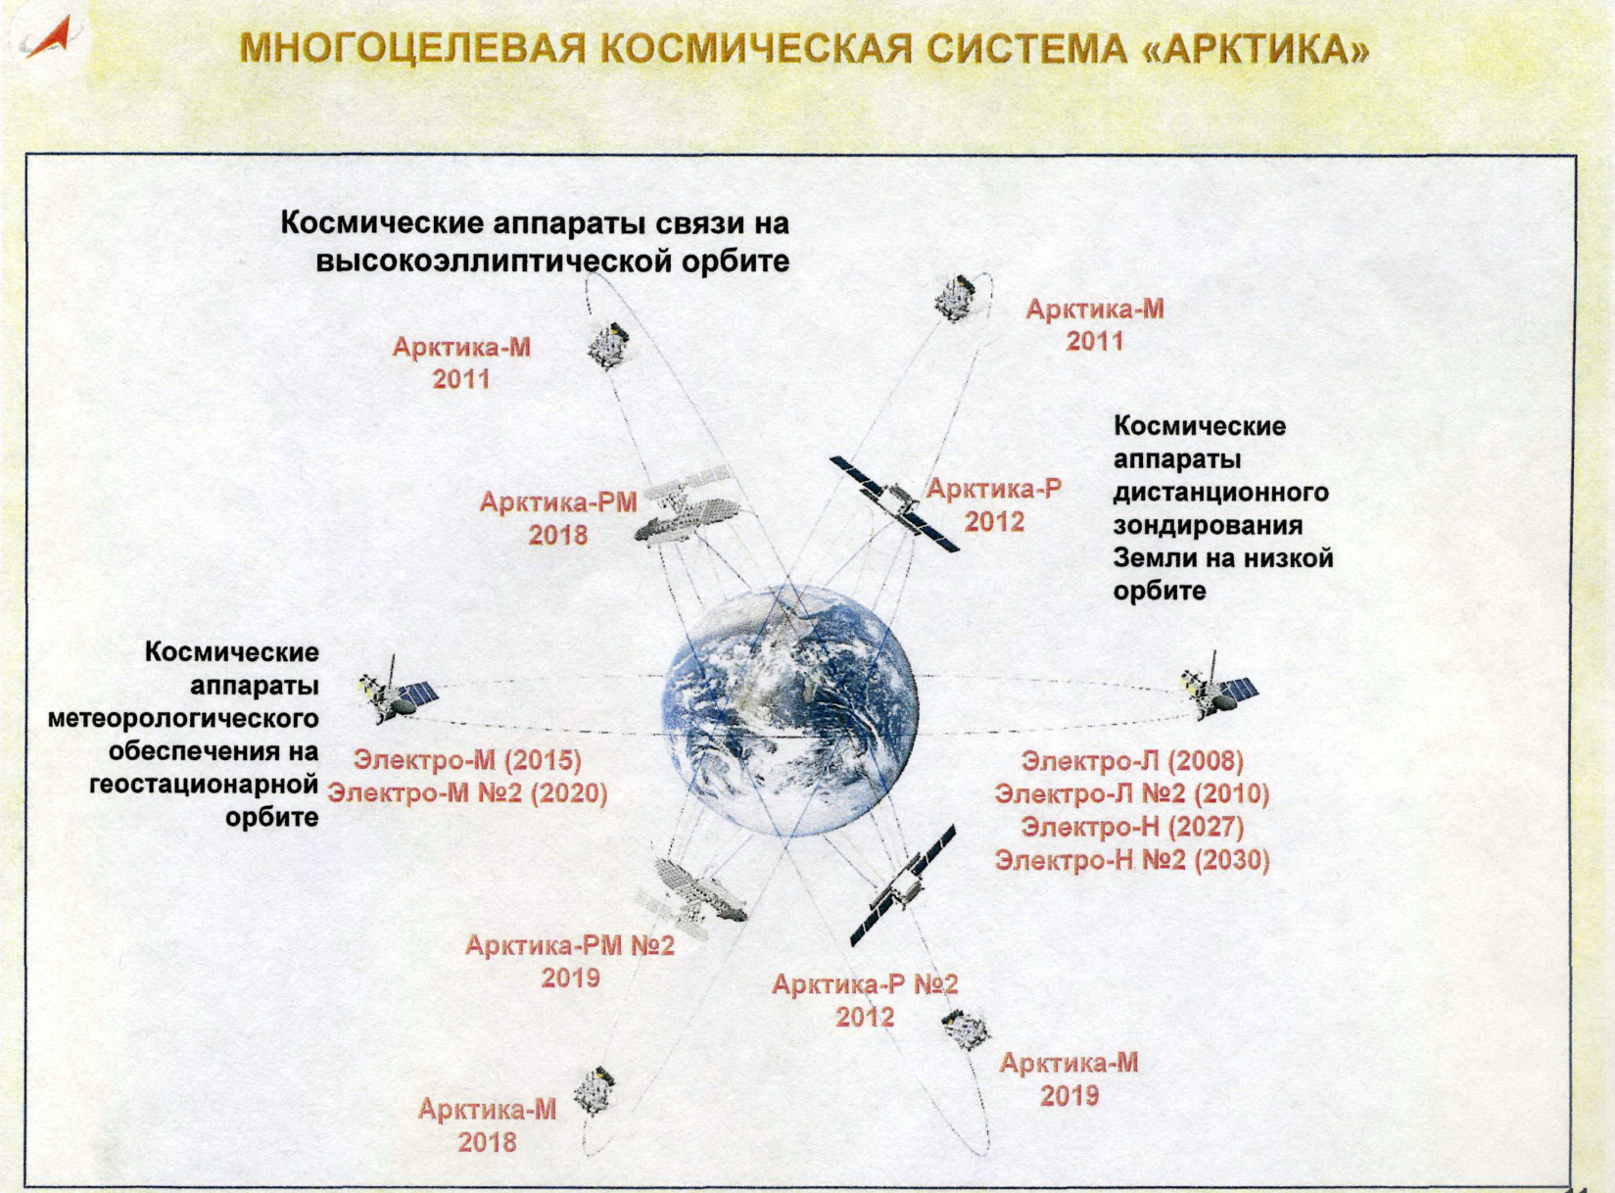
«Arctica» space system solves the specific needs in usage of space assets for the development of polar regions

Slide 24
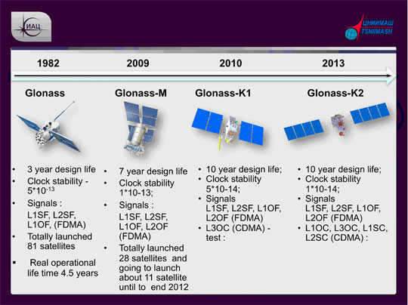
Development of national GLONASS satellite navigation system is a major political priority today.

Slide 25
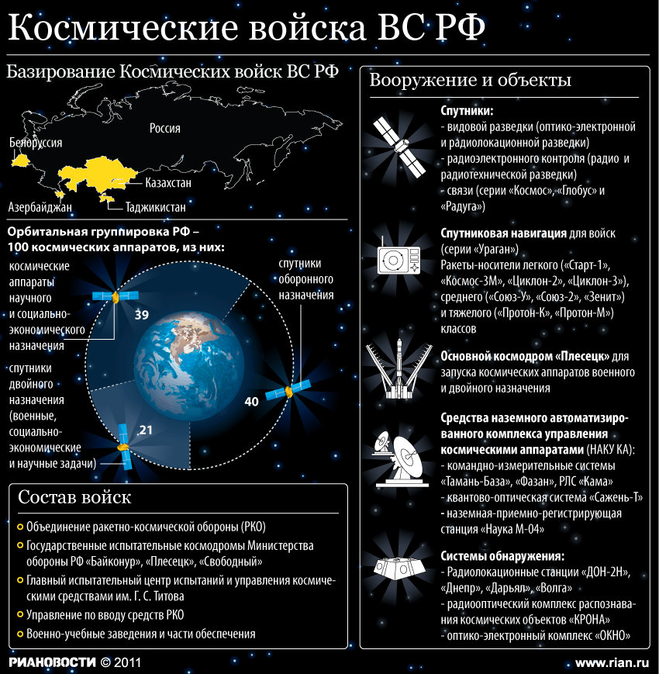
Space Forces of Russia

Slide 26
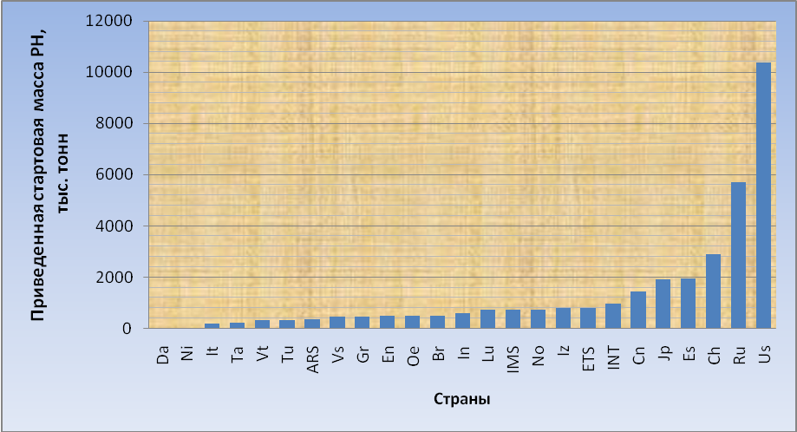
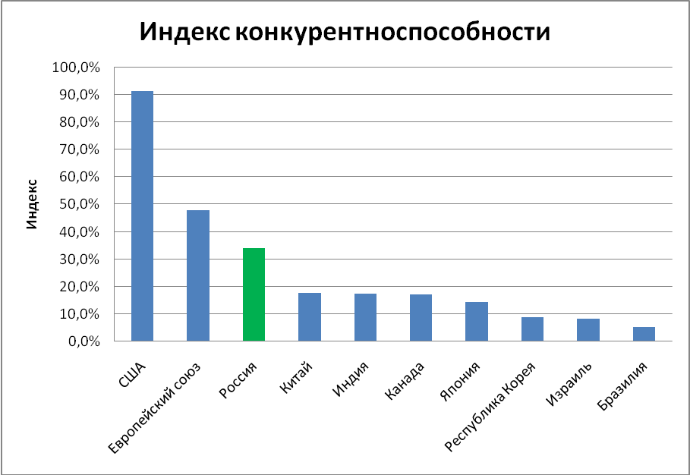
Place and role of Russian astronautics
List of Countries – members of space activities in 2008
№ | Страна | Обозначение | Число КА | Приведенная стартовая масса, т
1 | США | Us | 25 | 10356
2 | Россия | Ru | 21 | 5706
3 | КНР | Ch | 15 | 2890
4 | ESA | Es | 3 | 1943
5 | Япония | Jp | 5 | 1905
6 | Канада | Cn | 4 | 1434
7 | ИНТЕЛСАТ | INT | 2 | 942
8 | ЕВРОТЕЛСАТ | ETS | 2 | 780
9 | Израиль | Iz | 2 | 765
10 | Норвегия | No | 1 | 713
11 | ИНМАРСАТ | IMS | 1 | 713
12 | Люксембург | Lu | 1 | 713
13 | Индия | In | 4 | 570
14 | Бразилия | Br | 1 | 477
15 | ОАЭ | Oe | 1 | 471
16 | Великобритания | En | 1 | 467
17 | Германия | Gr | 9 | 433
18 | Венесуэла | Vs | 1 | 426
19 | АРАБСАТ | ARS | 1 | 346
20 | Турция | Tu | 1 | 313
21 | Вьетнам | Vt | 1 | 303
22 | Таиланд | Ta | 1 | 211
23 | Италия | It | 1 | 165
24 | Нидерланды | Ni | 1 | 2
25 | Дания | Da | 1 | 1

Slide 27
Perspectives of Russian aeronautics
Turning Point
In 2004, the United States defined its primary objective in space as “return to the moon." On October 2006 was published a new "national space policy of the U.S." approved by President Bush on August 31.
Space plans of the U.S. affected to the situation in Russian aeronautics
Dissatisfaction with the progress of space activities in Russia were clearly defined on November 2006 at the Round Table "National U.S. space policy: a reason to think the National Space Policy of Russia", organized by the Moscow Space Club. Materials of the Round Table were immediately reported to the authorities of Russian Federation . On December 2006 the President of Russia has decided to prepare a program of space activities for the next 30-40 years.
On April 15, 2010, Barack Obama announced a new space strategy of America: by 2015 to develop a new heavy launch vehicle for piloted flights to "deep space", and by 2025 to send a piloted complex beyond the lunar orbit, perhaps, to some of the asteroids. It is assumed that in the mid-2030s there will be performed flight to near to Mars orbit, followed by a further expedition to the Martian surface.
Ambitious planes were announced also by China and India
So, we can see «Race of space concepts»…
This phenomenon we can see not only at the international level, but also inside Russia among the major companies and organizations within space industry.

Slide 28
Perspectives of astronautics in Russia is based on existing official documents:
Such as:
Federal space program of Russian Federation for the period of 2006-2015
Strategies of space industry development till 2015
Policy of Russian Federation in regards of space activities till the year 2020 and further perspectives
Systematic view on implementation of an independent space activity of Russian Federation till 2040
Plan for Basic Research by Russian Academy of Sciences till 2025
…as well as published materials of Russian organizations and companies….
Someone can think, that discussions and papers are not very important and fruitfull.
To learn how such discussions and papers are transformed into large-scale construction, we can see on the example with the construction of launch site Vostochny.
This launch site will play a key role in the further development of Russian space exploration.

Slide 29
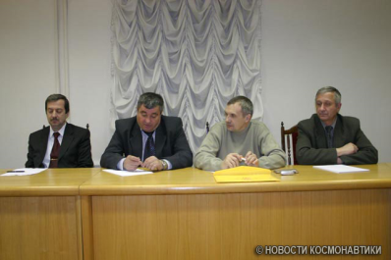
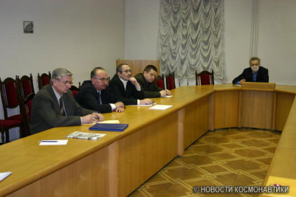
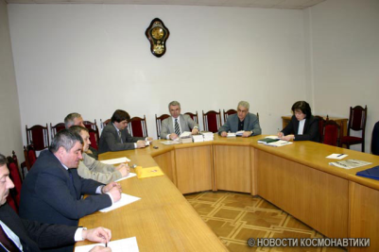
An example on launch site“Svobodny"
On February 2007 was issued a Decree on disband of the launch site “Svobodny“
The Moscow Space Club, acting in specific manner, has arranged a series of meetings and discussions….

Slide 30
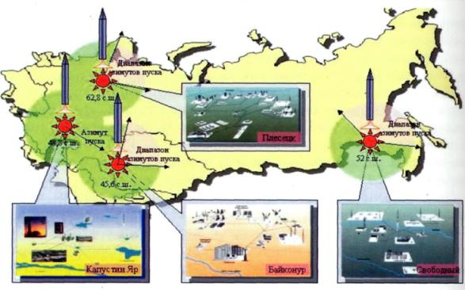
and prepared the necessary arguments and justification on…
Strategic Need
in the launch site Svobodny
for Russian Federation
is defined by its lack of limitations and drawbacks inherent in other launch sites or, in other words, the presence of full range of necessary parameters.

Slide 31
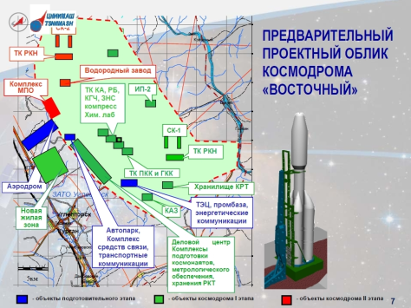
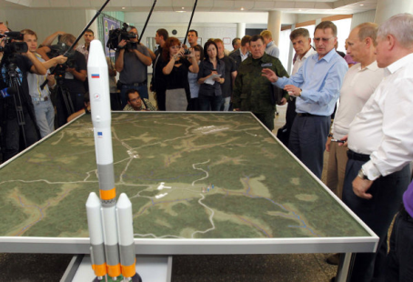
… as a result the decision about this launch site was changed to completely opposite…
Budget provides funds in amount of 24.5 billion rubles for construction of a new launch site for the period of the next 3 years.
The moto of the construction of the new launch site is : New launch site – New rockets - New space ships». Tenders for a new technical equipment are arranged and agreements are in process.
Launch site «Vostochny» is considered today as a key perspective of Russian Space Program

Slide 32
Next key element after Industry and Launch sites will be launch vehicles
By now leading Russian enterprises
presented their ideas of the technics

Slide 33
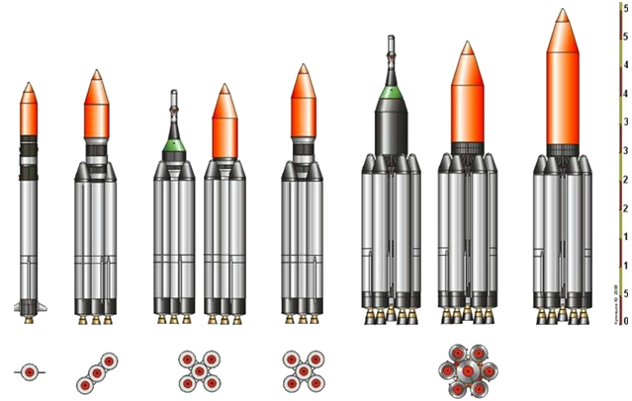
Launch Vehicles Angara Family
Ракета-носитель | Ангара-1.2 | Ангара-А3 | Ангара-А5П | Ангара-А5 | Ангара-А7П | Ангара-А7В
Стартовая масса, т | 171 | 480 | 713 | 759 | 1125 | 1154
Масса ПН, т (НОО) | 3,8 | 15,1 | 18,0 | 25,8 | 36 | 40,5

Slide 34
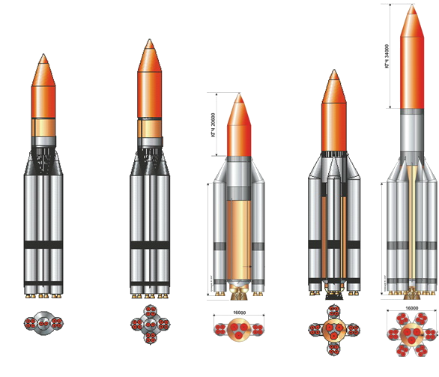
Launch Vehicle of 2 stage
Ракета-носитель | Амур-3 | Амур-5 | Енисей-3 | Енисей-5 | Енисей-7
Стартовая масса, т | 1615 | 2570 | 1500 | 2400 | 3560
Масса ПН, т (НОО) | 72 | 117 | 68 | 125 | 175

Slide 35
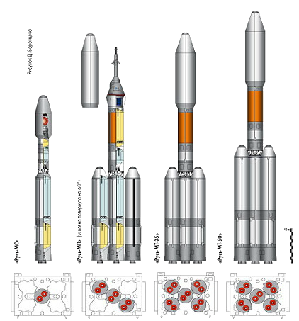
Perspective Launch Vehicles
“Rus” family
Ракета-носитель | Русь-МС | Русь-МП | Русь-МТ-35 | Русь-МТ-50
Стартовая масса, т | 235 | 673 | 1100 | 1433
Масса ПН, т (НОО) | 6,5 | 23,8 | 35 | 54

Slide 36
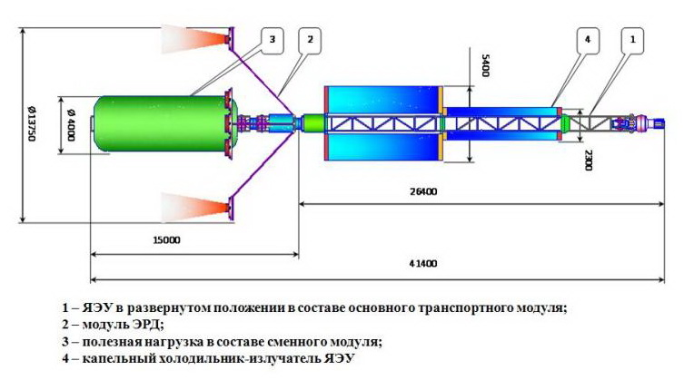
Reusable space tug with a nuclear power plant
megawatt-class
This project is actively supported by the President of Russian Federation
Financing is started, development is in progress
Notes:
Предполагаемый проект полностью удовлетворяет сформировавшимся к настоящему времени требованиям к использованию ядерной энергии в космосе, наиболее полно изложенным в резолюции ООН 47/68 от 14.12.1992 г. "Принципы, касающиеся использования ядерных источников энергии в космическом пространстве".

Slide 37
One of major priorities is to create an image of piloted aeronautics in Russia after MKS
First of all it is a Perspective Piloted Spacecraft and a new Multipurpose Orbital Station

Slide 38
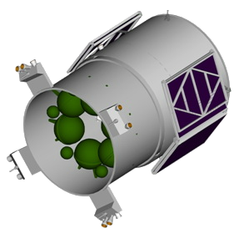
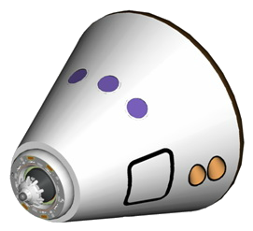
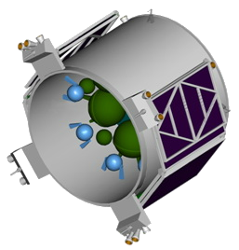
Perspective Transport Piloted Spacecraft
Service Module, Moon
Recovery vehicle
Service Module,
Earth orbit
This vehicle will provide:
flights in piloted and unpiloted modes;
autonomous flight duration up to 1 month, if in the MOS - up to 1 year
flight crew 4-6 and delivery of cargo to MOS up to 1500 kg,
lunar orbit flight with 3 persons crew,
autonomous flight and docking at the orbit of an artificial lunar satellite, in the orbit of an artificial satellite of Mars and in interplanetary space

Slide 39
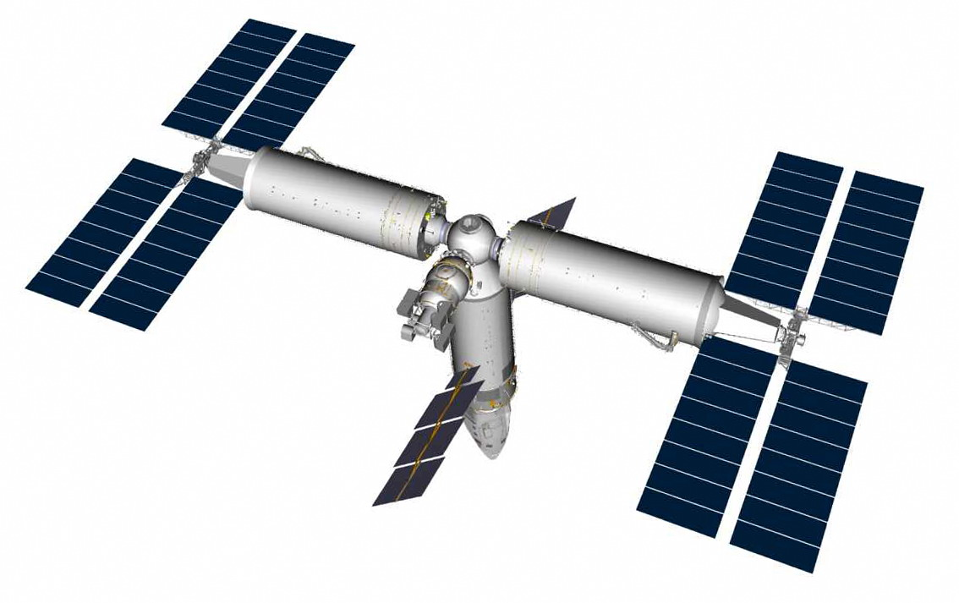
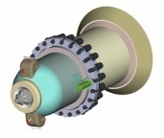
MULTIPURPOSE ORBITAL STATION
Goals:
Carrying out of fundamental research
Working out, assembly and maintenance of lunar and planetary complexes
Production of materials
Providing of the permanent presence of Russia in the near-Earth space
Expanding of market for space services (including hosting and servicing of space tourists)
Notes:
Автономные модули, обслуживание кораблей для дальнего космоса, масса 120 тонн.

Slide 40
Last two decades space flights for basic scientific research, as well as flights to the moon, planets and launch of space observatories has not been realized. However, main scientific enterprises of space industry continued to work and today they are ready to implement their projects.

Slide 41
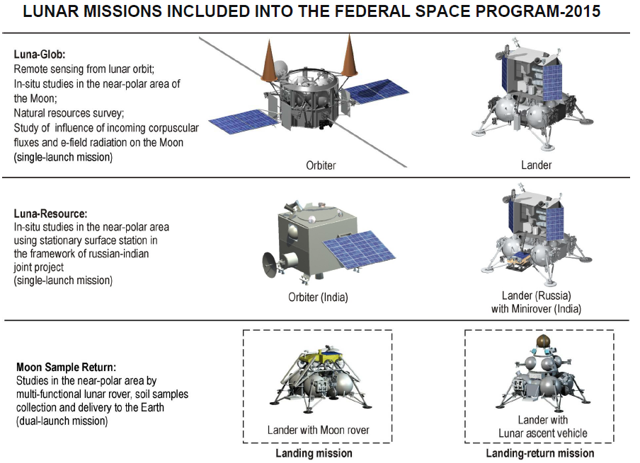

Slide 42
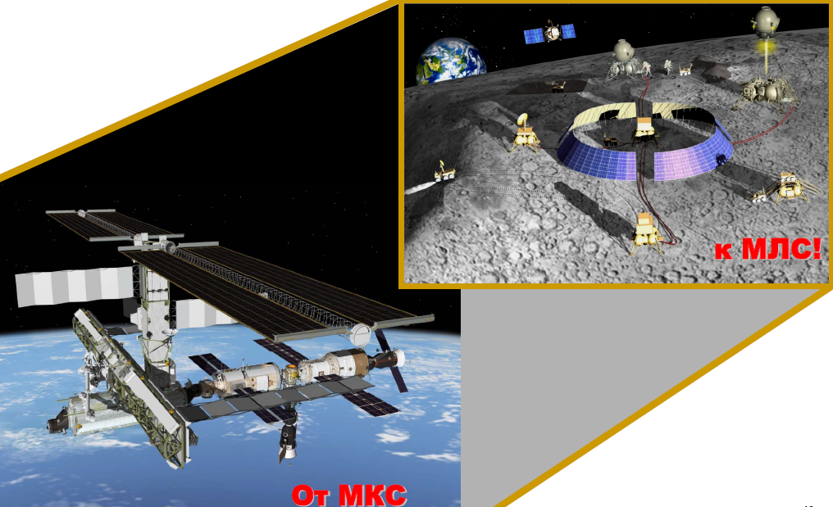
Most realistic concept of «return to the Moon» includes creation of highly robotic lunar base

Slide 43
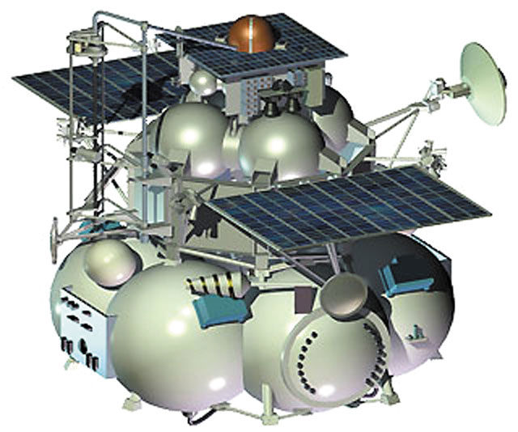
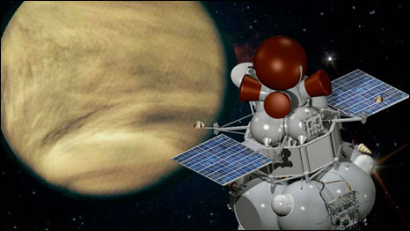
Solar System
Fobos-Ground, 2012
Venus–D, 2016

Slide 44
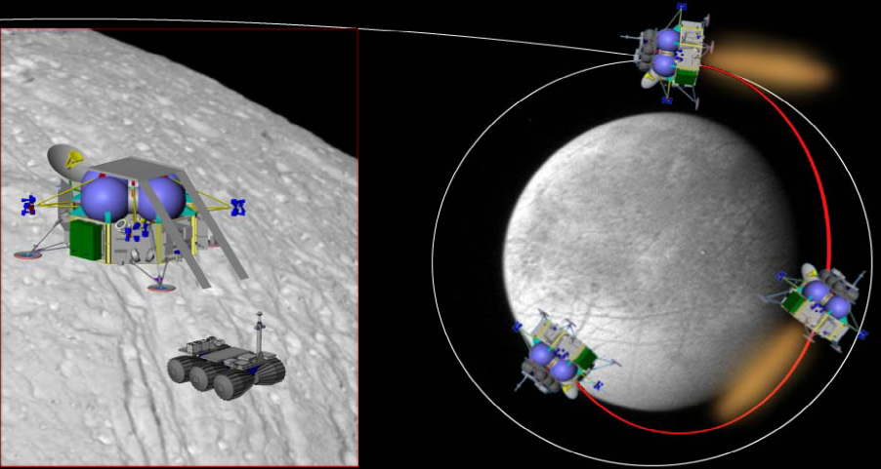
Jupiter-Europe (in collaboration with ESA)

Slide 45
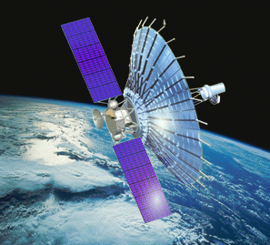
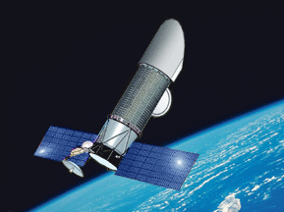
Family of the observatories:
Spector -R
International orbital astrophysical observatory of Radioastron project
Spector -UF
global cosmic observatory
Notes:
Планируемая дата запуска
Июнь 2011 года

Slide 46
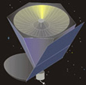
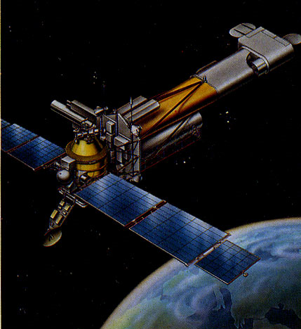
Milimetron -
Space complex for radio astronomy research in the millimeter range of the electromagnetic spectrum
Project Spector-X-ray-Gamma
Orbital astrophysical observatory designed to study the universe in gamma and X-ray spectral ranges

Slide 47
And finally– the most comlex projects of our century

Slide 48
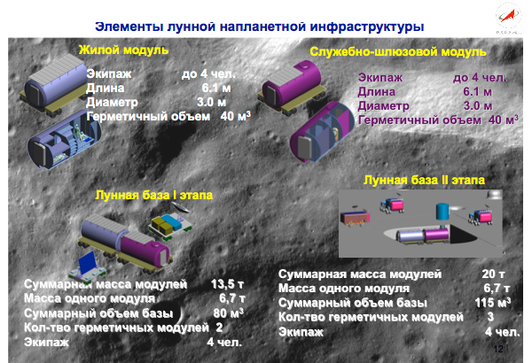
Elements of lunar surface infrastructure
Notes:
Хруничев

Slide 49

Scheme of the Martian piloted expedition
Notes:
Хруничев

Slide 50


Interplanetary expeditionary complex
The initial mass. . . . . . . . . . . . . . . . . . . . 500 tons
Capacity of nuclear power. . . . . . . . . . . . .24 MW
Mass of payload. . . . . . . . . . . . . . . . . . . .120 t
The specific impulse electric propulsion. . . 5000 - 9000 with
Thrust propulsion system. . . . . . . . . . . . . 50 kg
Cruising the working fluid. . . . . . . . . . . . . 260 t
Crew. . . . . . . . . . . . . . . . . . . . . . . . . . . .4 - 6 persons.
Resource. . . . . . . . . . . . . . . . . . . . . . . . .15 years
Notes:
Энергия

Slide 51
Some of the described briefly projects can be considered as fantastic... However…
Russia has all prerequisites for solving the objectives:
- natural resources (the volume and variety of the resources is the richest in the world);
- experience of space activities (extensive negative experience is also important);
- space infrastructure that can provide an implementation of any reasonable proposition;
- space and rocket industry (physical volume of production occupies first place in the world);
- specialists who are capable to solve any modern goal;
- general support from society side to solve any objective in the sphere
Cluster COSMOS created in Skolkovo Innovation Center shall contribute in perspective development of Russian aeronautics

Slide 52





SKOLKOVO

Slide 53
… participation in working out of recommendations for strategic development of Russian space exploration, in development of legal and regulatory framework, in formation of efficient schemes for mutually beneficial international cooperation….
Space Strategies in Russia
Flight to the Earth
Flight to the Stars
Infrastructure
of deployment
Orbital Grouping
АМС,
astrophysics
Piloting
FAP (?)
Procurement
Innovations
Education
Mars
Asteroids
Moon
Notes:
Добавить «Дальнюю перпективу»

Slide 54







To evaluate effectively the modern concept of development in this century, it is necessary to have an idea about the very distant future. Relevant conceptual development will not go unnoticed in Russia
Orbital settlements
Terraforming of Venus
Interstellar flights
90 atm => 1 atm
500С => 25C
Start of colonization of the Galaxy
Only 10 mln years are needed in case of implementation of the exciting technologies
Notes:
ДАРПА выделила 1 млн долларов на исследование концепции межзвездных полетов.

Slide 55


Zhukov Sergey
Cluster of Space Technologies of Skolkovo, President of Moscow Space Club
zh-sergei@yandex.ru
http://mosspaceclub.ru/
http://www.i-gorod.com/cosmos/
Moiseev Ivan
The Head of the Space Policy Institute (Russia),
Science Adviser, Moscow Space Club.
i_mois@mail.ru
http://path-2.narod.ru

